Slide 1
C2P India
QA Track - SPIRA

Slide 2

TABLE OF CONTENTS
1
Add- Ins
2
Overview
3
Release/Iteration
4
Requirement
5
Test Sets
6
Test Cases /Folder creation
7
Custom Fields
6
Custom Fields
8
Test Case Execution
9
Test Run
10
Reporting

Slide 3
Overview
SpiraTest manages your project's requirements, tests, bugs and issues in one environment, with complete traceability from inception to completion.
Manage requirements, features and use-cases
Create, edit and execute test-cases
Track bugs, enhancements, risks and issues
Map tests to requirements to track coverage
Clean and powerful user interface
Support for template test cases
Link bugs to test steps during test execution
Drill down from requirements to tests and incidents
Personalized dashboards and customizable reporting
Web-based graphs and reports

Slide 4
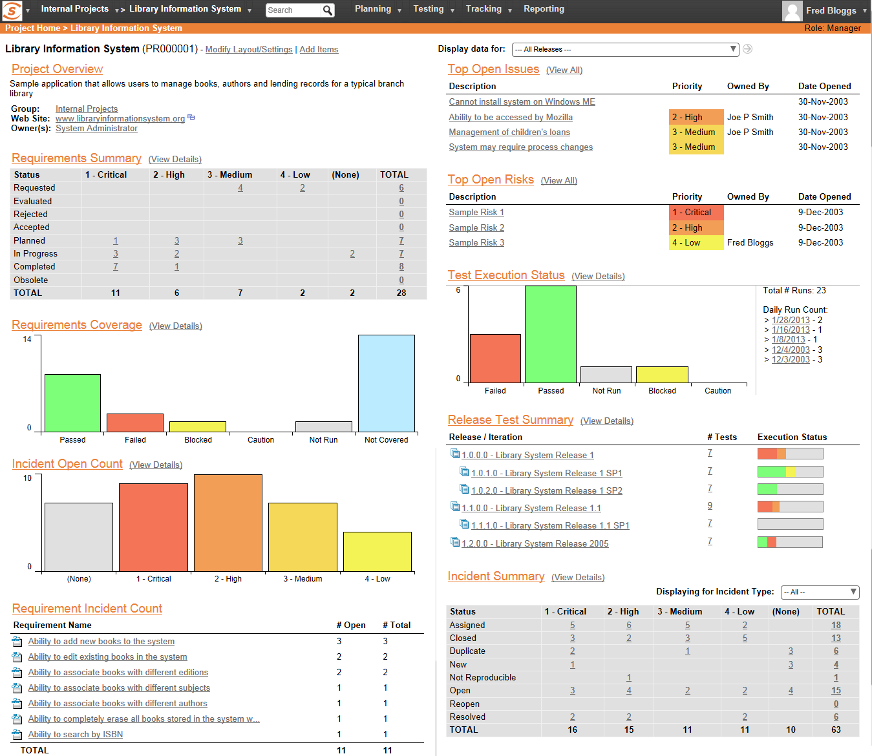
Overview
Each project has a dashboard home-page that summarizes all of the information regarding the project into a comprehensive, easily digestible form.
It provides a “one-stop-shop” for people interested in understanding the overall status and health of the project at a glance.

Slide 5
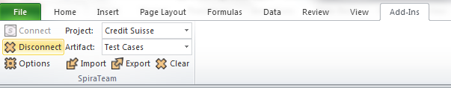
Add-Ins
Go to Inflectra web site (http://www.inflectra.com/SpiraTest/Downloads.aspx) and download/Install Spira Test MS-Office 2007 add-in.
Test Cases Template can be downloaded: https://svn-mec.clear2pay.com/svn/repos/rd/core/OPF/trunk/doc/QA/Documentation/SpiraImportTemplate.xlsm
In excel Add Ins tab should be visible where the user will be connected to the project.

Slide 6
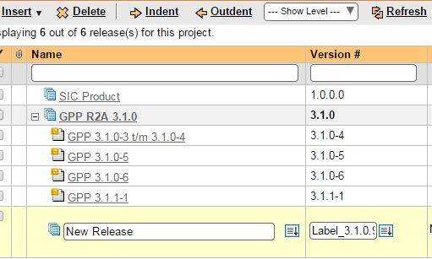
Release/Iteration
In Spira Navigate to Planning->Release.
Insert a Release/Iteration on Project basis.

Slide 7
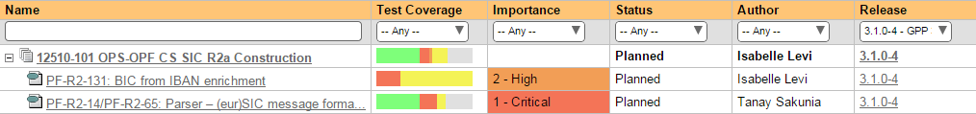
Requirement
In Spira Navigate to Planning->Requirement. Create a Requirement per Project feature/Use Case/Importance/Release/Type

Slide 8
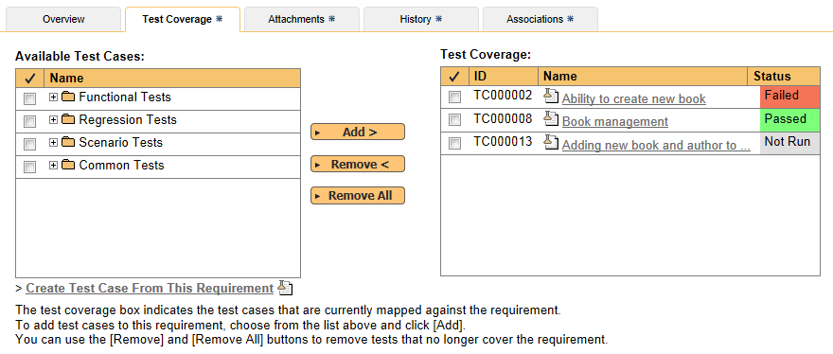
Requirement
Each requirement is mapped to one or more test cases that can be used to validate that the functionality works as expected.

Slide 9
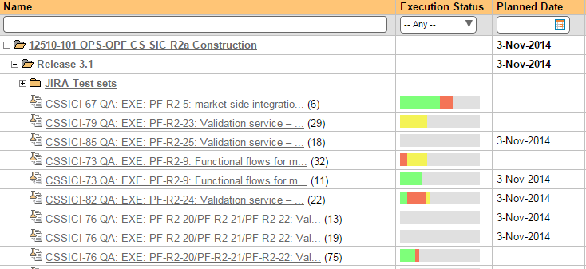
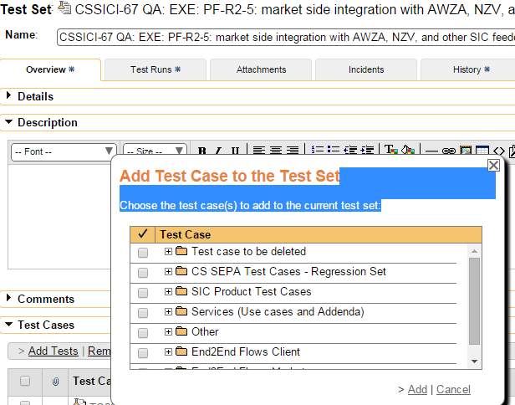
Test Sets
Navigate to Testing>Test Sets. Create a Test Set per Requirement.
Map Test Cases to Test Set using Add Tests link.

Slide 10
Custom Fields
All Custom fields can be filled in by using a dropdown menu pointing to the related section under the lookup tab.
Dropdown lists will allow the user to select ‘simple’ or ‘complex’ instead of 821, 822…
2 buttons are added into lookup sheet allowing the user to switch from a version ‘Ready to be exported’ to a ‘User Friendly’ version and vice-versa.
Cutom drop down field values needs to be added in Spira.
Custom field values in look up tab in excel needs to be taken from Spira Project.

Slide 11
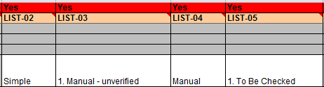
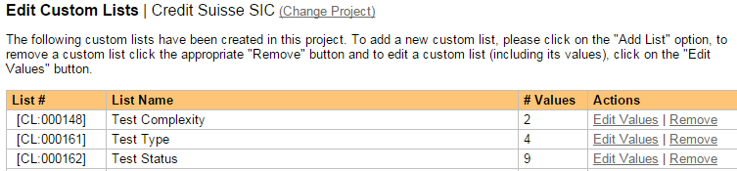
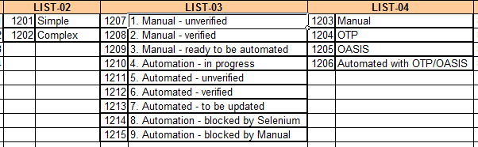
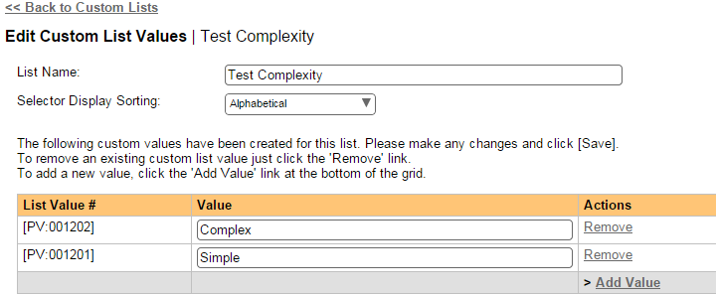
Custom Fields
Custom fields in Test Case/Look Ups Tab
Spira->Administration-> Custom Properties

Slide 12
Test Cases /Folder creation
Click on Add-In menu, Connect to Spira by providing correct URL and user credentials.
Write test cases, define folders, sub-folders. To create sub-folders, remember to use the increase indent option (Ctrl + Alt + Tab) and the correct option in “Type” column of “Test Cases” tab.
To import to Spira, click the export button in excel add-in menu. The sheet gets updated with IDs of test folders / test cases / test steps.
Add Requirement ID, Release ID, Test Set ID from Spira into excel(Column F,G,H respectively).

Slide 13
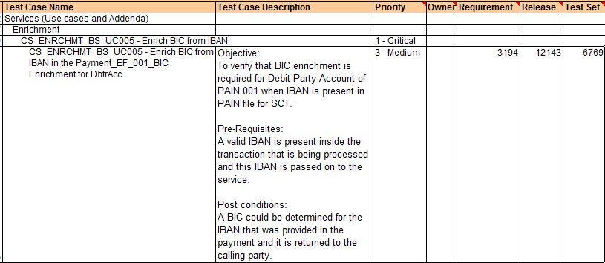
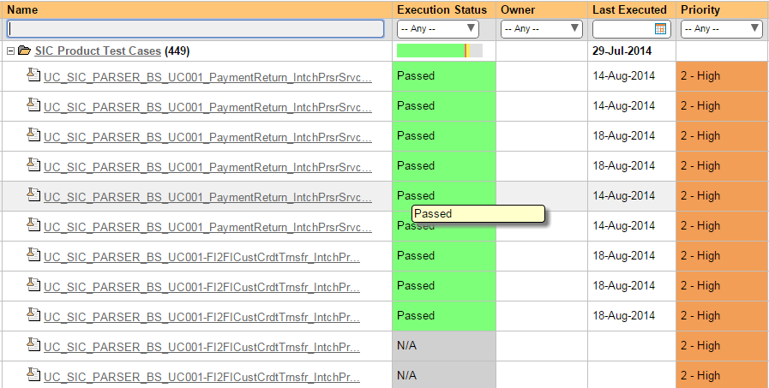
Test Cases /Folder creation
Test Cases/Folder in Excel
Test Cases/Folder in Spira

Slide 14
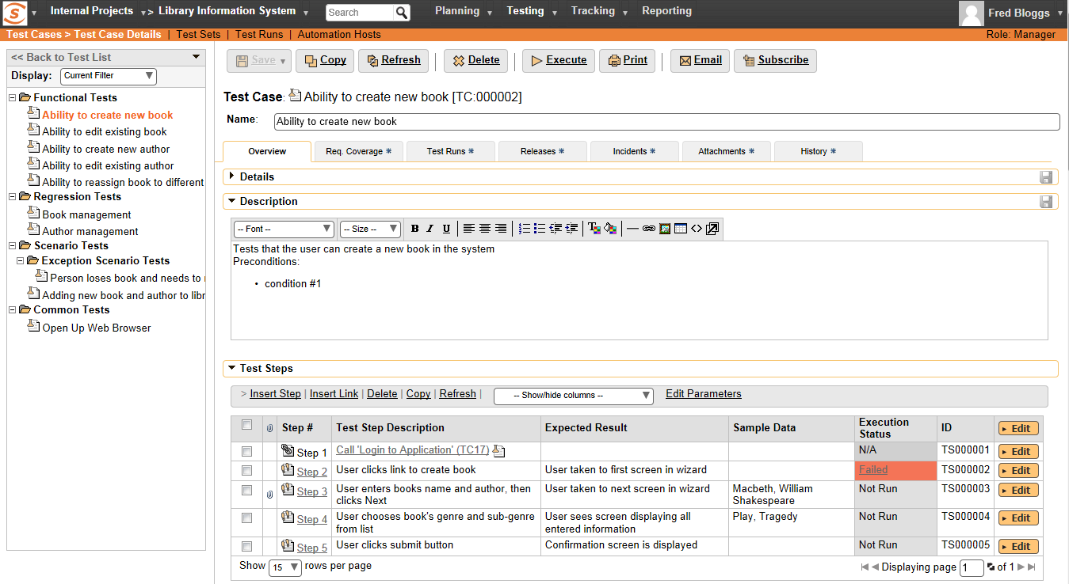
Test Cases /Folder creation
Each test case consists of a set of test steps that represent the individual actions a user must take to complete the test.
You can include other template test cases as steps within your test case. This allows you to build a library of reusable test components.

Slide 15
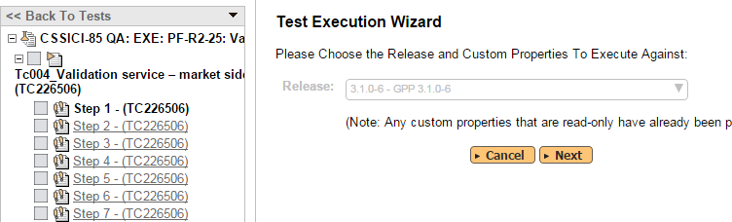
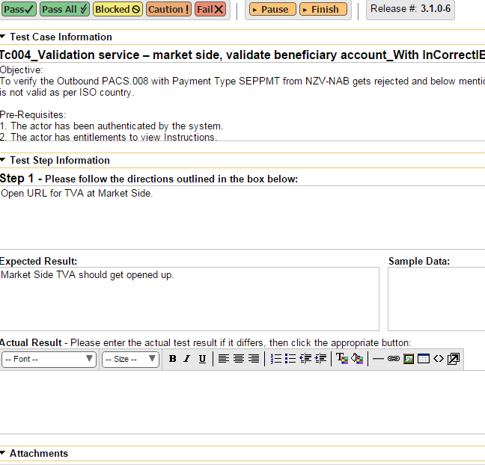
Test Case Execution
From Test Set Select and Execute the TC
Pass/Fail/Block the TC after execution. Add Results/Data/attachments

Slide 16
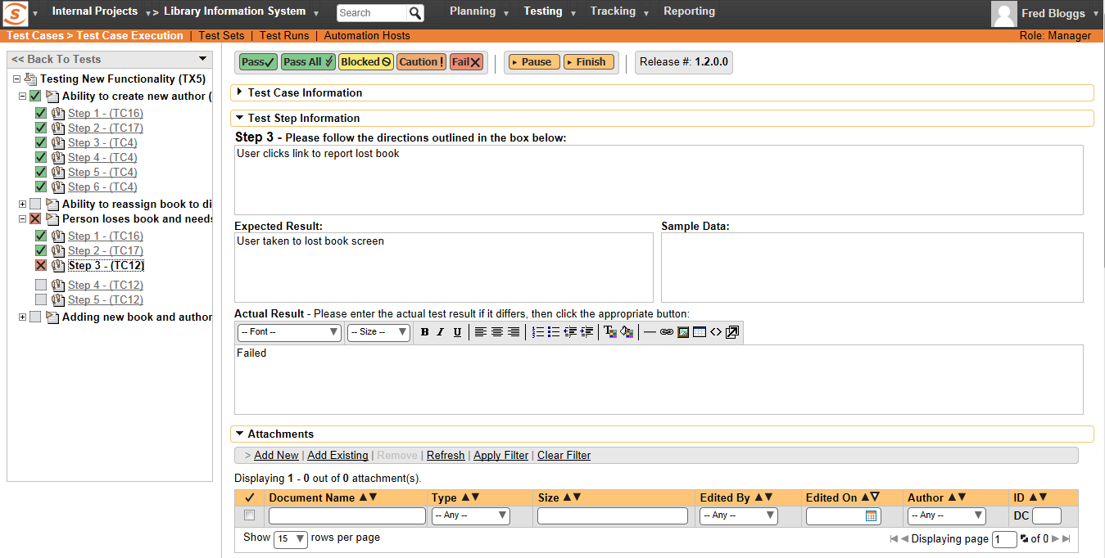
Test Case Execution
You can execute groups of test cases - along with their test steps – so that the testers can follow the instructions and determine if the system being tested behaves as expected. Optionally a new incident can be raised in the system – linked to the test step failure

Slide 17
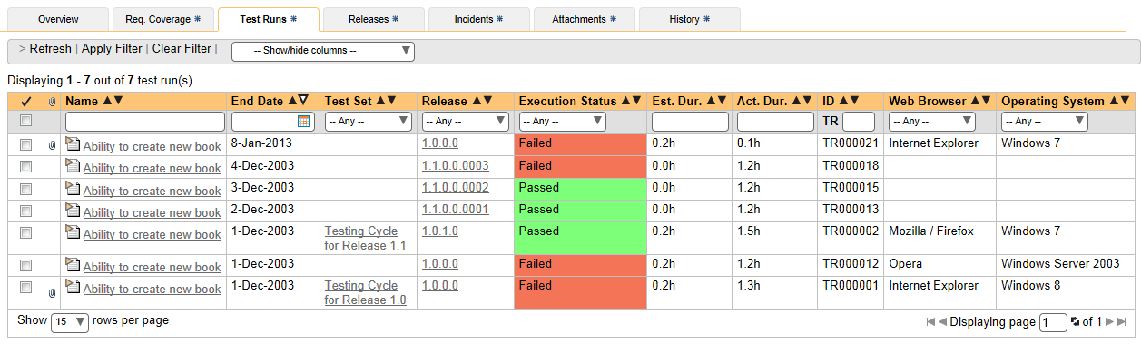
Test Run
Every time you execute a test case, SpiraTest records every pass / failure as well as the associated incidents generated as a ‘Test Run’. These archived Test Runs can be viewed to determine if changes to the system have introduced failures to previously working functionality.

Slide 18
Reporting
Navigate to Reporting-> Create report.
User has an option to create report for requirements, test cases, incidents and releases
Select values in Standard field filters as per the requirement and generate the report.
User also has an option to generate various graphs for Requirement, Test Cases.
Report can be generated in various formats like MS word, Excel , Adobe Acrobat PDF,etc.

Slide 19
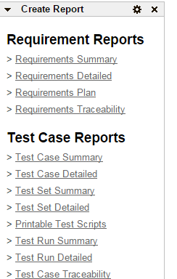
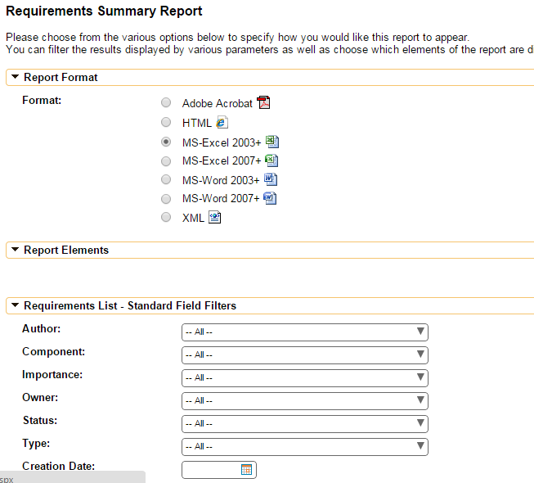
Reporting
Reporting options
Select the appropriate Report/Format

Slide 20
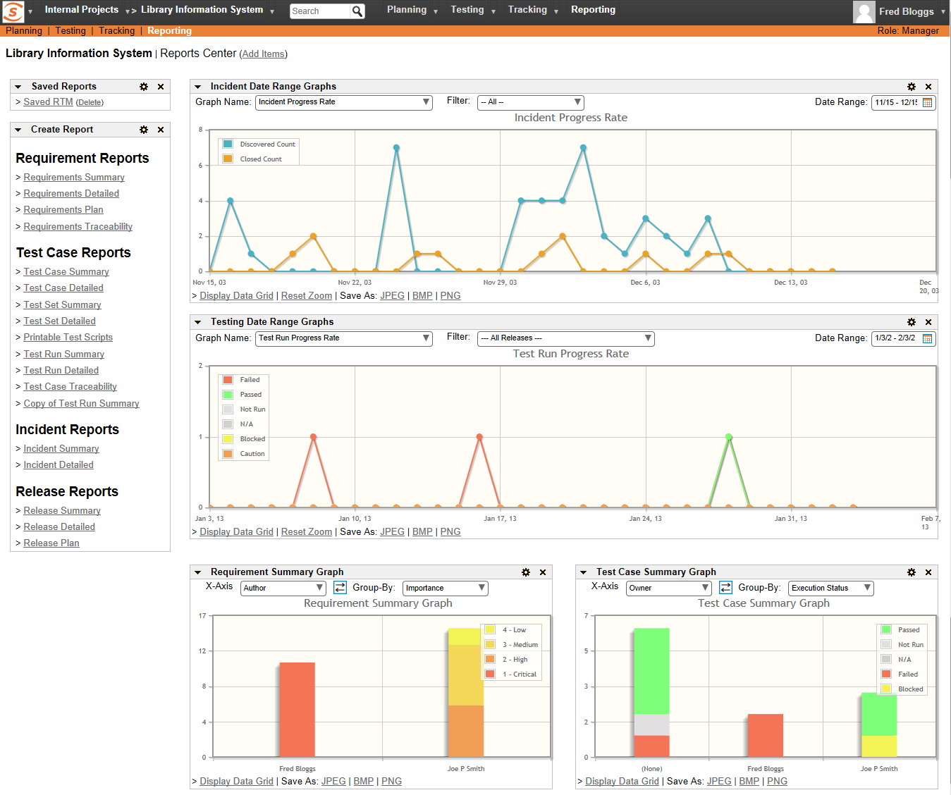
Reporting
SpiraTest includes an extensive reports library that can display information such as Requirements Coverage, Test Case Execution, and Incident Status.
SpiraTest allows you to build a customized reporting dashboard featuring your frequently-used graphs, charts and reports.
The graphs available include: Requirements Coverage, Test Run Progress, Incident Discovery Rate, Cumulative Artifact Counts

Slide 21
Questions?

